Slide 1
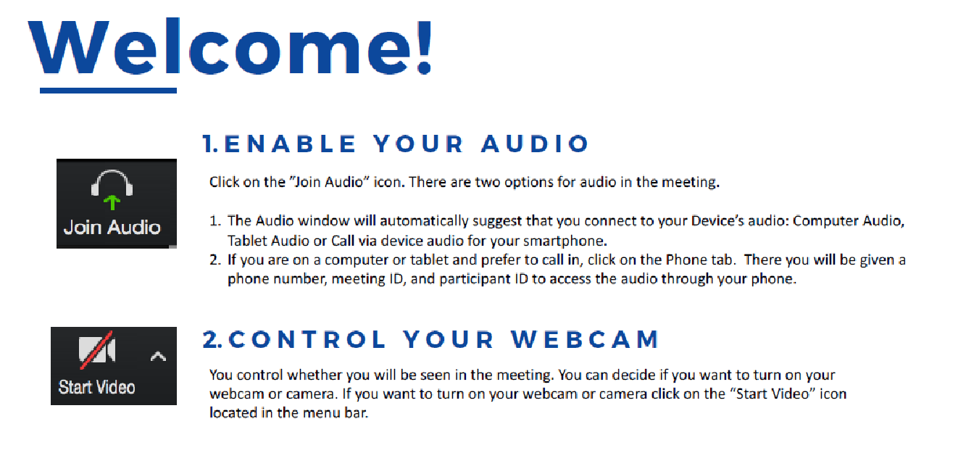

Notes:
1

Slide 2
DBSA Online Support Group
Today’s Facilitator:
XXXXXX XXXXXXXXXXXXXX
Notes:
2

Slide 3
Meeting Overview
Gathering time
  Welcome and Overview
  DBSA Welcome
  Group Guidelines
Check-in
Sharing and Support
Positive Close
Notes:
3

Slide 4
DBSA Welcome Statement
Welcome to our online support group! We are a support group of DBSA (Chapter) which is an independent affiliate of the Depression and Bipolar Support Alliance. This session is led by and created for peers (individuals living with mood disorders). Our mission is to provide hope, help, support, and education to improve the lives of people who live with mood disorders.
I am not here as licensed professional. DBSA believes that each person follows their own path to wellness; we each choose to make that journey in the company of other supportive members. My role is to keep our discussion going and to help maintain a supportive and productive environment. To do that, I may occasionally ask a question or make a comment to help the flow of the conversation and move the discussion along.
Our meetings are designed to give everyone an opportunity to participate, as they are comfortable. After reading the DBSA Support Group Guidelines, we will begin the meeting with a brief check-in. After the check-in, we will have an open discussion about living with mood disorders by sharing our experiences and the strategies that improve our lives. We often end with a closing activity to help us leave committed to action.
Now let’s read the DBSA Support Group Guidelines to remind us that we are all responsible for following and committing to the group standards, which are in place to keep this group a safe place to share.
Is there a volunteer to read the first guideline?

Slide 5
DBSA Support Group Guidelines
Share the air
Everyone who wishes to share has an opportunity to do so. No one person should monopolize group time.
One person speaks at a time
Each person should be allowed to speak free from interruption and side conversations.
What is said here stays here
This is the essential principle of confidentiality. It MUST be respected by all.
Differences of opinion are o.k.
We are ALL entitled to our own point of view.
We are all equal
We accept cultural, linguistic, sexual orientation, gender non-conformity, social and racial differences and promote their acceptance.
Use “I” language
Because we do not participate in discussion groups as credentialed professionals, NO ONE CAN INSTRUCT. We however can share from our own personal experiences. As an example, we cannot say – “you should do X.” We can say: “when I was faced with a similar problem, I…” Always put things in the context of our own experiences.
It’s o.k. not to share
People do not have to share if they do not wish to.
It’s everyone’s responsibility to make the discussion groups a safe place to share.
We respect confidentiality, treat each other with respect and kindness, and show compassion.
Notes:
- Review DBSA Guidelines:
- How have you used these?
- Use as a shield.
- Last one my favorite
- Spread responsibility / EMPOWERMENT
- DEMONSTRATION TABLE!
- Confidentiality exception: safety
5

Slide 6
Check-In
This is a chance for each of us to find out who else is in this virtual room. Through our shared lived experience this lets us know that we are not alone.
Say your first name
Say something about yourself (like a fun fact or something you enjoy doing, you do not have to share your diagnosis)
In a few words, say why you came to the meeting today

Slide 7

Talk Time
Share the air
Everyone who wishes to share has an opportunity to do so. No one person should monopolize group time.
One person speaks at a time
Each person should be allowed to speak free from interruption and side conversations.
What is said here stays here
This is the essential principle of confidentiality. It MUST be respected by all.
Differences of opinion are o.k.
We are ALL entitled to our own point of view.
We are all equal
We accept cultural, linguistic, social and racial differences and promote their acceptance.
Use “I” language
Because we do not participate in discussion groups as credentialed professionals, NO ONE CAN INSTRUCT. We however can share from our own personal experiences. As an example, we cannot say – “you should do X.” We can say: “when I was faced with a similar problem, I…” Always put things in the context of our own experiences.
It’s o.k. not to share
People do not have to share if they do not wish to.
It’s everyone’s responsibility to make the discussion groups a safe place to share.
We respect confidentiality, treat each other with respect and kindness, and show compassion.
Notes:
- Review DBSA Guidelines:
- How have you used these?
- Use as a shield.
- Last one my favorite
- Spread responsibility / EMPOWERMENT
- DEMONSTRATION TABLE!
- Confidentiality exception: safety
7

Slide 8
Closing
To finish today’s group,
Let’s each share a FUN activity we will do
OR
A step we hope to take toward wellness
this next week

Slide 9
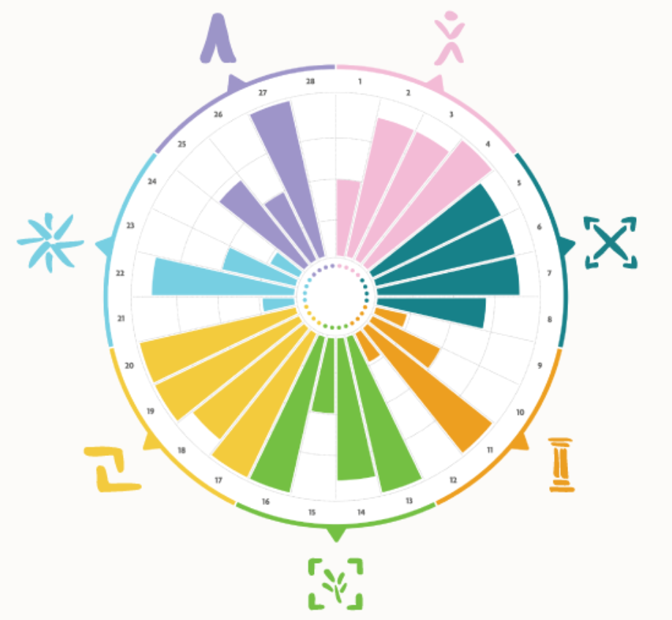
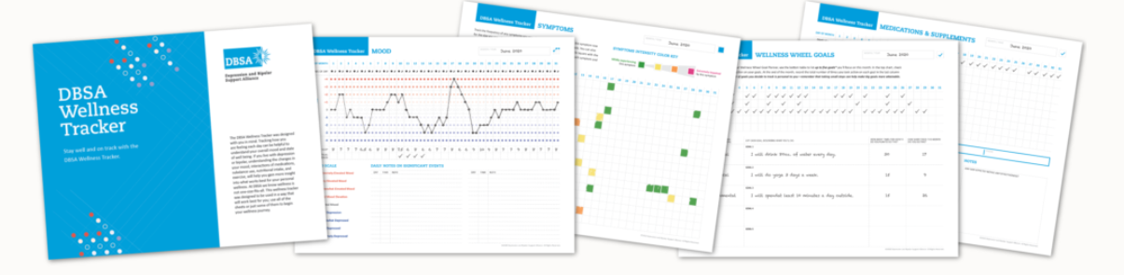
Thank you for joining us today!
Please take a minute to complete the post group survey. Your responses are completely confidential and help us to improve this group.
Keep in touch with peers between meetings
Visit DBSAlliance.org for a wealth of information on depression and bipolar disorder, as well as access to tools in the DBSA Wellness Toolbox – the DBSA Wellness Wheel and Wellness Tracker

